Slide 1
Jason Hopkins, ATC
Certified Athletic Trainer

Slide 2
What determines whether or not to pull an athlete from a game or practice and for how long?
The decision to disqualify an athlete from play on the day of the concussive episode is based on the sideline evaluation (SCAT3), the symptoms the athlete is experiencing, the severity of the symptoms, and the athlete’s past history.
Any episode involving a LOC or persistent symptoms related to a concussion (headache, dizziness, amnesia, and so on).
Athletes who are symptomatic at rest and after exertion for at least 15-20 minutes should be disqualified from returning to activity that day.

Slide 3
Pulling the concussed athlete /and for how long?
Sideline exertional activities include but are not limited to jogging, followed by sprinting, sit-ups, push-ups, and any other non contact sports activities.
How long for recovery?
Recovery varies from athlete to athlete
Athletes with a history of concussion have a slowed recovery time.
Younger (pediatric) athletes may take longer to recover than older athletes.

Slide 4
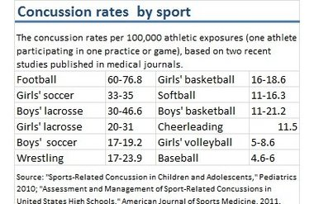
Which sports are most impacted?
Concussions can happen at anytime in any sport but the incidence is higher in collision and contact sports.

Slide 5
What is the follow-up with coaches, teachers, doctors, athletes, and parents once an athlete is diagnosed with a concussion?
Once the athlete has been thoroughly evaluated and determined to have sustained a concussion, a comprehensive medical management plan should be implemented (this should be planned in the preseason).
The plan should include frequent medical evaluations (usually weekly), and observations (daily), continued monitoring of post concussion signs and symptoms, and post-injury cognitive and balance testing.
All information should be relayed to the school nurse, teachers, counselors, and parents.

Slide 6
How can school work affect a student with a concussion?
Doing school work and being in a classroom sometimes makes the symptoms of a concussion worse. Going to school or doing school work also means it could take longer for the brain to heal after a concussion.
When the brain doesn’t heal as fast it can hold the athlete back. Student athletes may not do as well on tests or other assignments.

Slide 7
Symptoms of concussion

Slide 8
What are some warning signs teachers/counselors should be made aware of when working with students athletes with a concussion?
Appears dazed or stunned
Is confused about events
Answers questions slowly
Repeats questions
Can’t recall events prior to the hit, bump or fall
Can’t recall events after the hit, bump or fall
Loses consciousness (even briefly)
Shows behavior or personality changes
Forgets class schedule or assignments

Slide 9
The concussion screening process/tests
ImPACT (Immediate Post-Concussion Assessment and Cognitive Testing)
One important piece of the overall concussion evaluation and management process.
It is a sophisticated test of cognitive abilities
A tool to help healthcare professionals track recovery of th cognitive process following a concussion
A tool that helps communicate post-concussion status to athletes, coaches, parents, clinicians.

Slide 10
Impact concussion summary

Slide 11
Scat 3 form

Slide 12
Return to school protocol

